Slide 1
Knowledge Modeling and Knowledge Management
Lecture 0 - Course Overview
Prof. Li Yao
©Spring 2020, Li Yao

Slide 2
Instructor Information
Prof. Li Yao
Science and Technology on Information Systems Engineering Laboratory
College of Systems Engineering
National University of Defense Technology
Mobile Phone: 13755130950
Phone: 506423(O)
Email: liyao6522@sina.com
liyao@gfkd.mtn
©Spring 2020, Li Yao

Slide 3
Course Topics
Overview of Knowledge Modeling and Management
Knowledge Modeling and Representation
Formal Techniques in Ontology Engineering
Developing Methodologies and Tools
Knowledge Discovering and Extracting
Principles of Knowledge Management and their applications
©Spring 2020, Li Yao

Slide 4
Contents
Overview of Knowledge Modeling and Management
Knowledge Modeling and Techniques
Knowledge Discovering and Extracting
Developing Methodologies and Tools
Principles of Knowledge Management and their applications
©Spring 2020, Li Yao

Slide 5
Class Information
Time
  Monday, 19:40- 22:15 p.m. (13-19week)；
  Wednesday, 19:40- 22:15 p.m. (14-18week).
Location
  01-204
©Spring 2020, Li Yao

Slide 6
Prerequisites
Discrete Mathematics or background in logic;
The Principles of Information Systems or background in information systems.
©Spring 2020, Li Yao

Slide 7
Course Description
This course will explore
  theoretical techniques for the design and analysis of formal Knowledge Model,
  using knowledge models to realize Knowledge Management from big data and information systems perspectives.
  using knowledge models to solve the problems in real world intelligently.
©Spring 2020, Li Yao

Slide 8
Project
Each student must complete a project of his or her choice (subject to the instructor’s approval).
  The project will consist of the design and evaluation of an ontology in some domain.
  In this year，the theme of the research is robust knowledge model.
©Spring 2020, Li Yao

Slide 9
Literatures
Knowledge Engineering Review.
Data mining and knowledge discovery
Data & knowledge engineering
IEEE Transactions On Knowledge And Data Engineering
Machine Learning
Knowledge-Based Systems
Artificial Intelligence
Management Information Systems
AI Magazine
IEEE Intelligent Systems
Journal of Knowledge Management
Harvard Business Review.
Organization Science
Management Science
Intellectual Capital
Fortune Magazine
©Spring 2020, Li Yao

Slide 10
Grading
Project Discussion: 30%
  Project proposal: 10%
  Project progress report: 10%
  Project presentation: 10%
Research Report: 70%
©Spring 2020, Li Yao

Slide 11
Course Requirements
Attending lectures regularly
Keeping up with the readings according to the syllabus.
©Spring 2020, Li Yao

Slide 12
Course Resources
雨课堂
github
  https://github.com/liubin0314/Knowledge-Management-and-Knowledge-Modeling
微信群
  2020知识建模与知识管理
©Spring 2020, Li Yao

Slide 13
Textbook and Readings
There is no required textbook for this course.The following books and papers are strongly recommended.
  Ronald J. Brachman and Hector J. Levesque (2003), Knowledge Representation and Reasoning, Morgan Kaufmann Publishers.
  Kimiz Dalkir. Knowledge Management in Theory and Practice, Elsevier, 2005
  语义网基础教程.Grigoris Antoniou &Frank van Harmelen.机械工业出版社，2018
  Nonaka, Ikujiro (1994) A dynamic theory of organizational knowledge creation. Organizational Science 5(1), Feb. 14-37.
  John Sowa. Knowledge Representation. China Machine Press，2003.5
  Alavi, Maryam, and Dorothy Leidner (2001) Knowledge Management and Knowledge Management Systems: Conceptual Foundations and Research Issues. MIS Quarterly 25(1) March. 107-136.
  Uschold, M. and Gruninger, M.(1996), Ontologies: Principles, Methods, and Applications, Knowledge Engineering Review, 1:96-137.
  Tom Dietterich. Steps toward robust artificial Intelligent.
  Tom M. Mitchell. Machine Learning. China Machine Press，2003.5
©Spring 2020, Li Yao

Slide 14
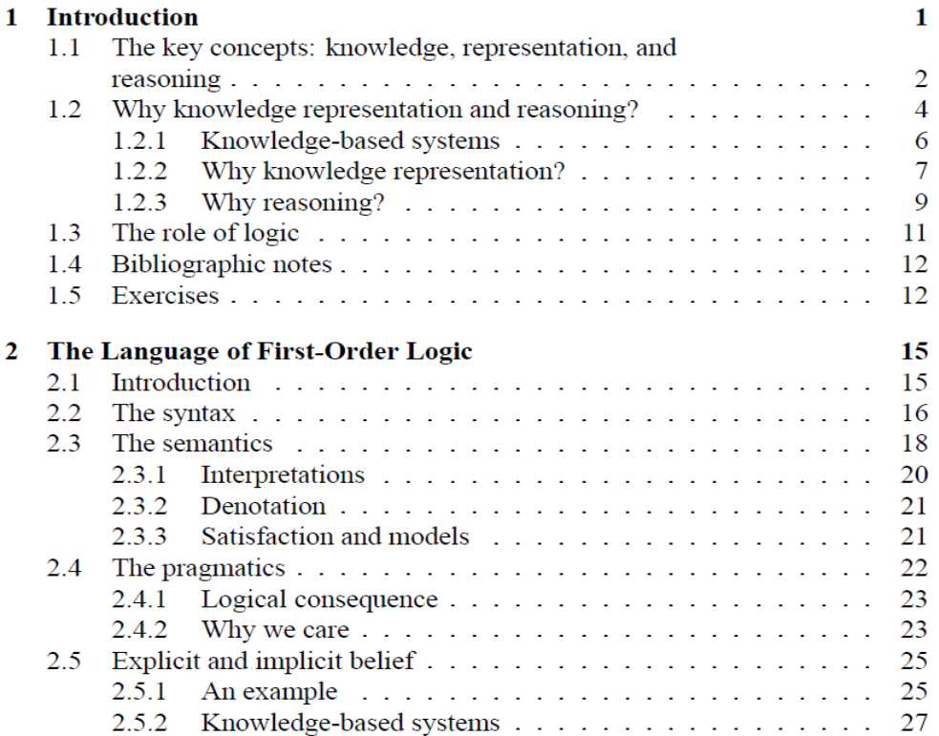
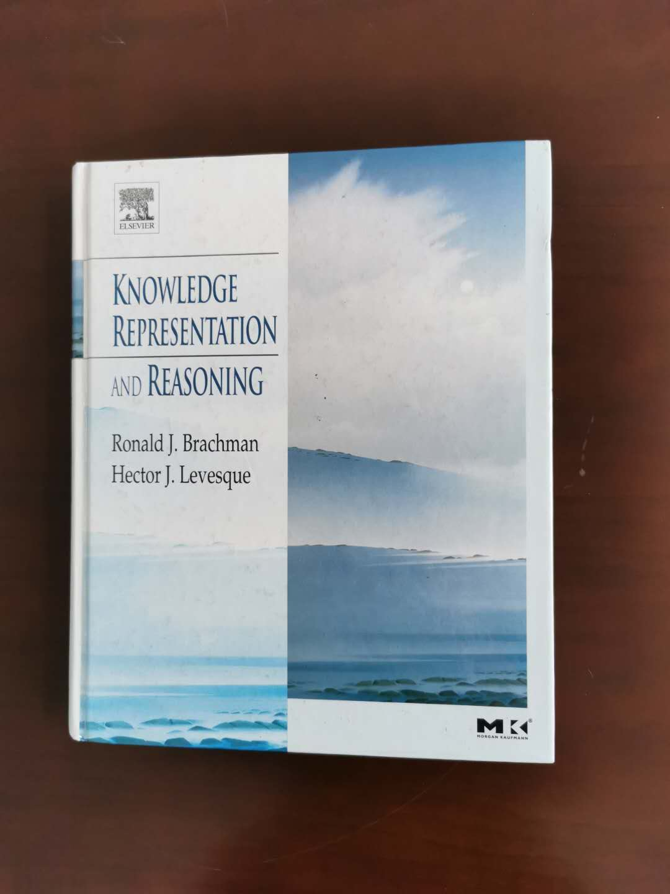
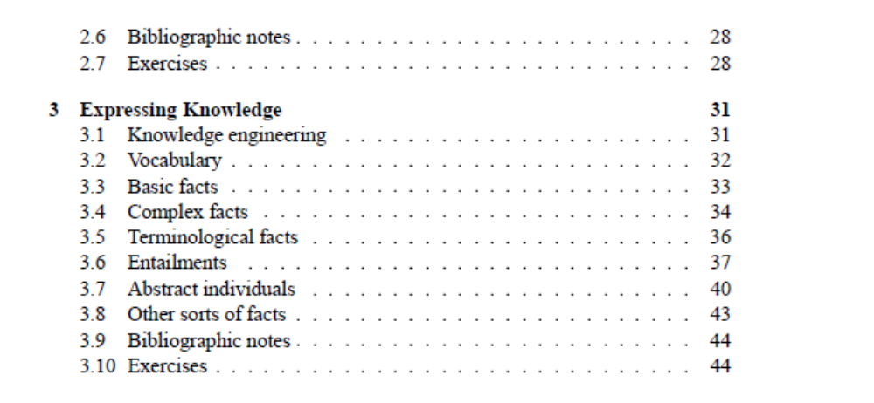
Knowledge Representation and Reasoning
©Spring 2020, Li Yao

Slide 15
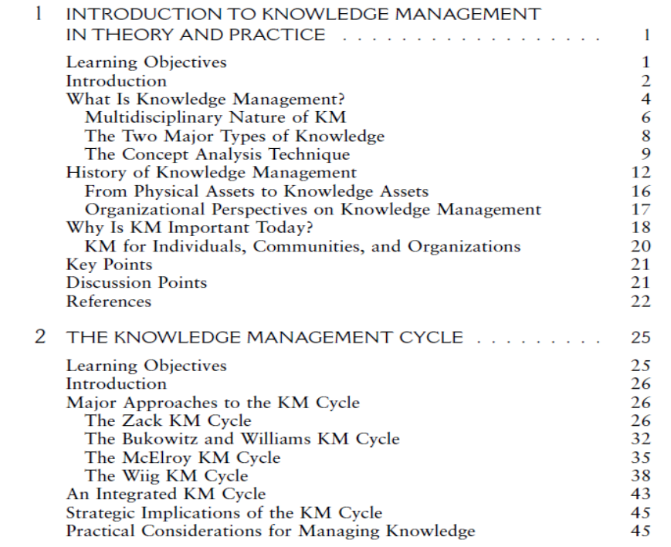

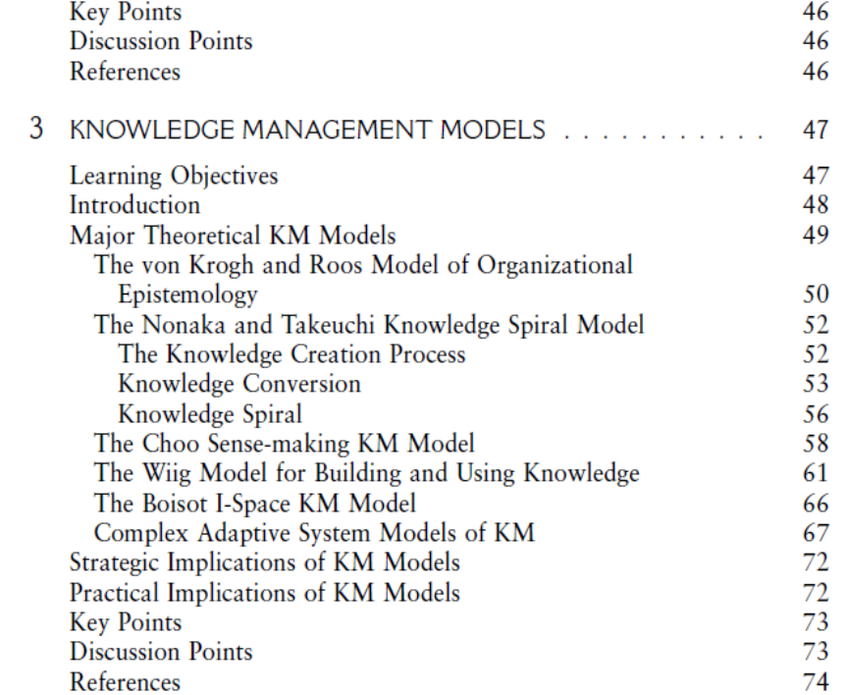
Knowledge Management in Theory and Practice
©Spring 2020, Li Yao

Slide 16

语义网基础教程
网络本体语言OWL
资源描述框架RDF
语义网规则语言SWRL
©Spring 2020, Li Yao

Slide 17
Course Schedule
Lecture | Day | Date | Lecture Topic
1 | Monday | May 11 | Course Overview； Overview of Knowledge Modeling and Management（1）
2 | Monday | May 18 | Overview of Knowledge Modeling and Management（2） Knowledge modeling and ontologies (1)
3 | Wednesday | May 20 | Knowledge modeling and ontologies (2)
4 | Monday | May 25 | Discussion for Proposals.
5 | Wednesday | May 27 | Formal techniques in ontology engineering（1）
6 | Monday | June 1 | Formal techniques in ontology engineering（2）
7 | Wednesday | June 3 | Ontology developing Methodologies and tools
8 | Monday | June 8 | Progress Reports
9 | Wednesday | June 10 | Knowledge Discovering and Extracting ( 1)
10 | Monday | June 15 | Knowledge Discovering and Extracting ( 2)
11 | Wednesday | June 17 | Principles of Knowledge Management
12 | Monday | June 22 | Project Presentations
©Spring 2020, Li Yao

